Slide 1

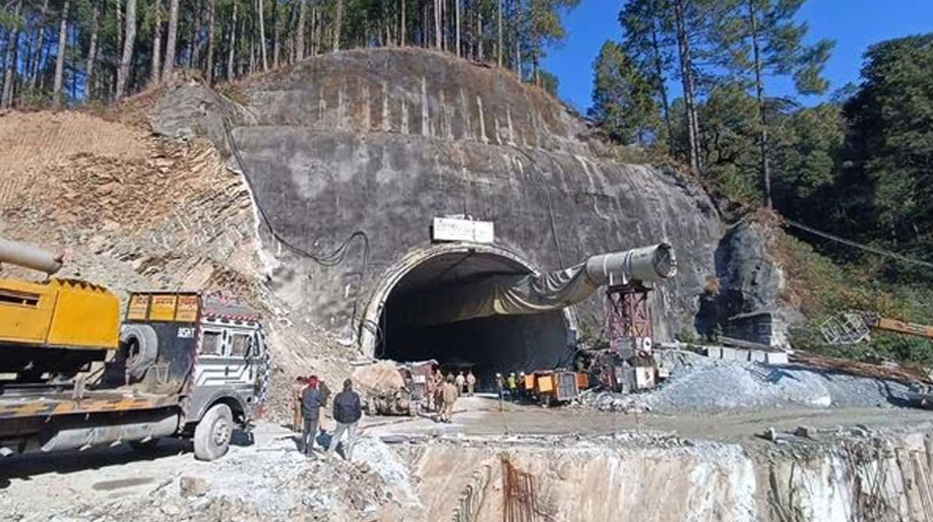
Introduction to the Silkyara tunnelcollapse incident in Uttarakhand

Slide 2
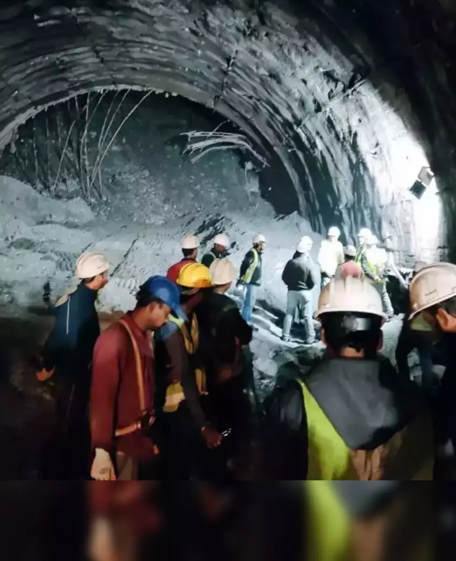
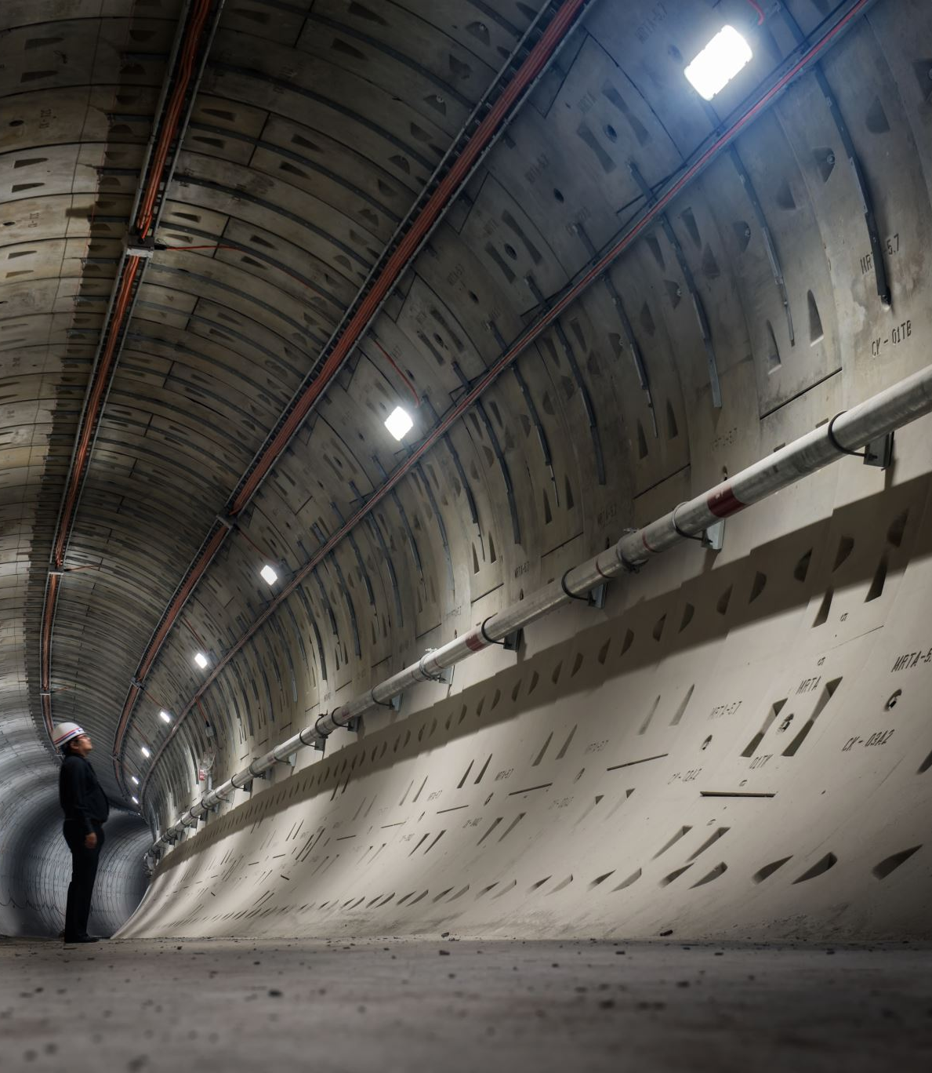
2023 Uttarakhand Tunnel Disaster
Introduction to the concept of the ripple effect and how it applies to this incident
The 2023 Uttarakhand Tunnel Disaster shook the entire nation as a tunnel collapse trapped multiple workers. The unfortunate event occurred during construction, leading to a complex and challenging rescue operation. The disaster brought to the forefront the need for stringent safety measures and protocols in infrastructure development. Let's delve into the details to understand the severity and impact of this tragic incident.

Slide 3
Immediate Response
Detailed description of the extensive rescue operations launched immediately after the collapse
Introduction to the challenges faced and their ripple effects on the overall rescue efforts

Slide 4
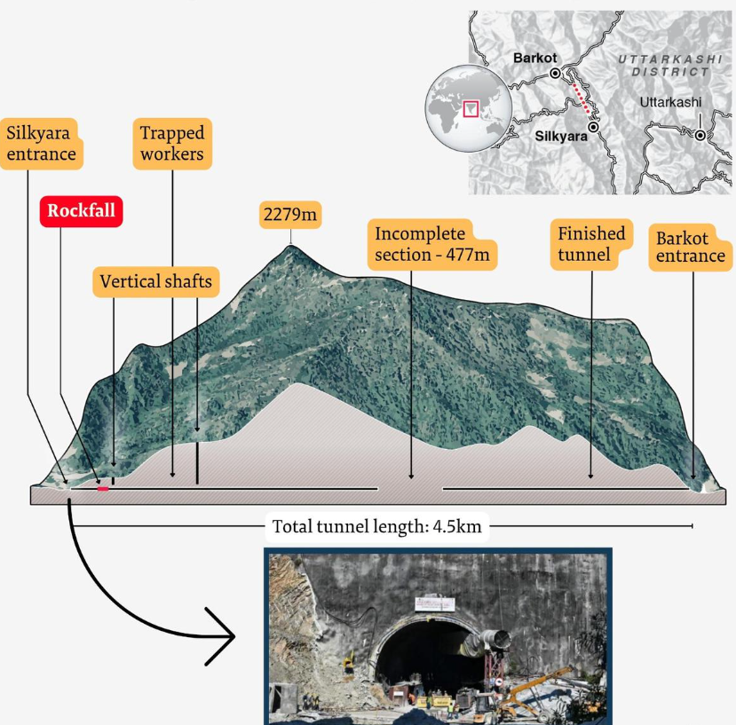

Technical Challenges
Highlighting the technical glitches encountered, particularly with the auger machine
Discussion on how these challenges had ripple effects, causing delays and additional complications in the rescue operation

Slide 5

Environmental Concerns
Explanation of the environmental challenges posed by the Himalayan region
Discussion on how these concerns had ripple effects on rescue operations, necessitating additional precautions and strategies

Slide 6
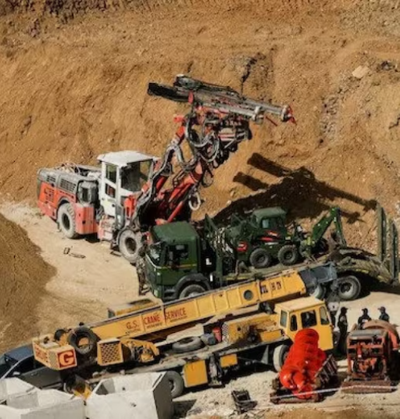

Logistical Issues
Addressing the logistical challenges faced due to the remote location of the tunnel
Discussion on how these logistical issues had ripple effects on the overall coordination and efficiency of the rescue operation

Slide 7
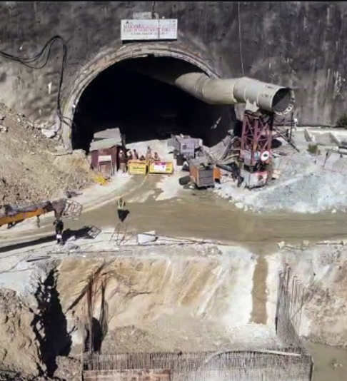
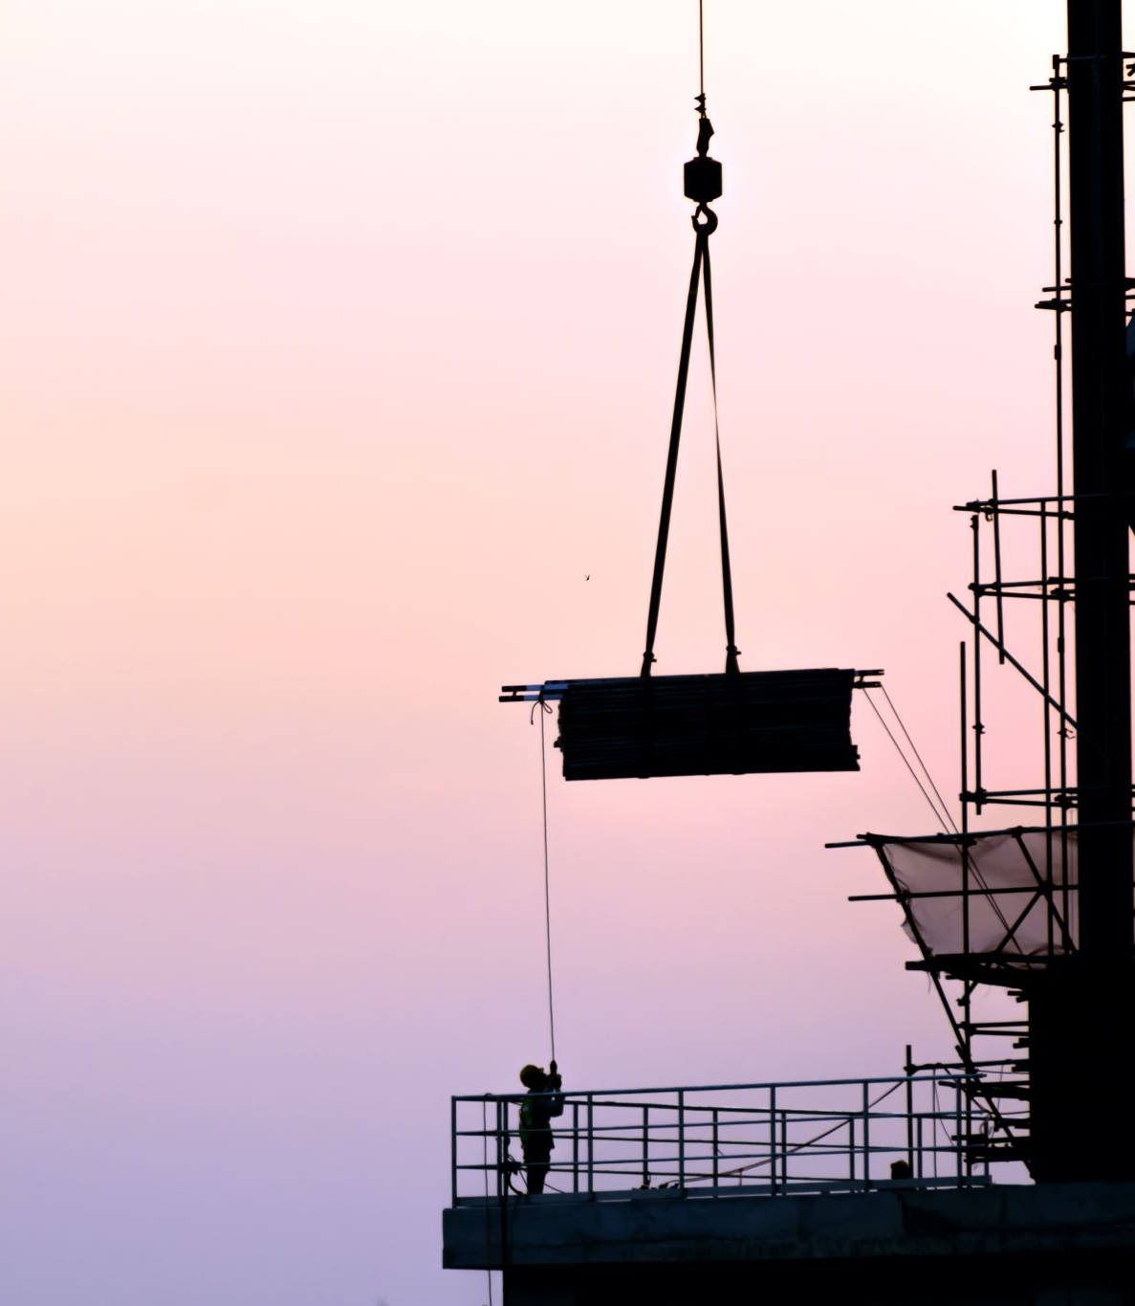
Safety Protocols
In-depth discussion on the questions raised about safety standards during the tunnel's construction
Explanation of how the lack of adherence to safety protocols had ripple effects, impacting worker safety and project integrity

Slide 8
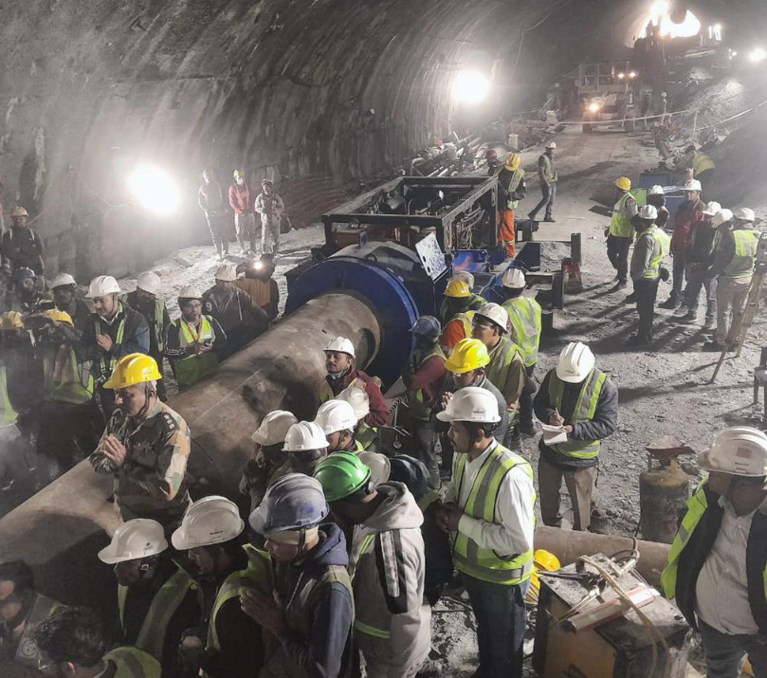
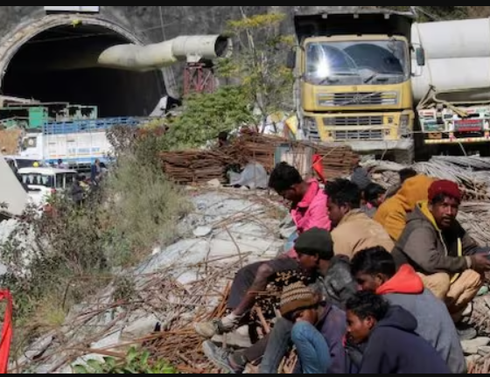

Worker Welfare
Emphasis on the importance of ensuring the well-being of workers, especially those from marginalized backgrounds
Discussion on how neglecting worker welfare had ripple effects, affecting morale, productivity, and community trust

Slide 9
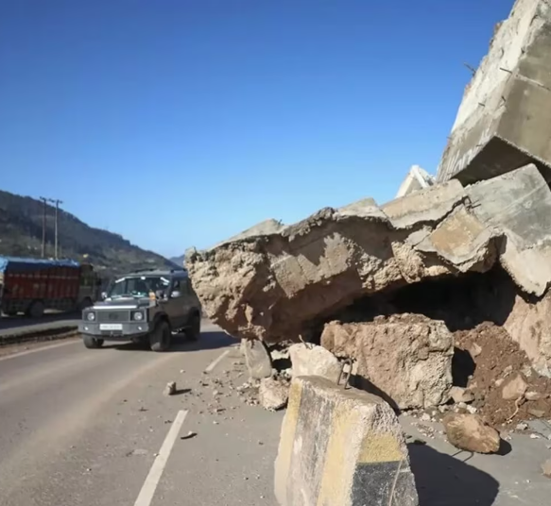

Environmental and Economic Impact
Analysis of the environmental sustainability implications of the tunnel collapse
Examination of the ripple effects on the local ecosystem and long-term economic repercussions on the region's development

Slide 10

Lessons Learned and Conclusion
Enhanced Safety Measures
Implementing stringent safety protocols and regular inspections can help prevent such disasters in the future. It's essential to prioritize worker safety and well-being in all construction projects.
Emergency Response Preparedness
Disaster management teams must be equipped with the latest technology and training to handle complex rescue operations effectively. Preparedness can make a significant difference in mitigating the impact of such incidents

Slide 11
Future Disaster Preparedness-
Early Warning Systems
Implementing advanced monitoring and early warning systems can alert authorities to potential risks, enabling proactive measures to prevent disasters.
Training and Drills
Regular drills and training for emergency response teams and workers can improve readiness and ensure swift and coordinated action in crisis situations.
Technological Integration
Integrating state-of-the-art technologies such as AI and drones into disaster management strategies can significantly enhance response capabilities.

